Slide 1

Working with Assistants Part 14: Managing Vector Stores

Slide 2



Notes:
https://www.youtube.com/channel/UC35ZpwldGw7ZJ5R-2sLijzw

Slide 3
Creating Vector Stores
More Details on Vector Stores

Slide 4
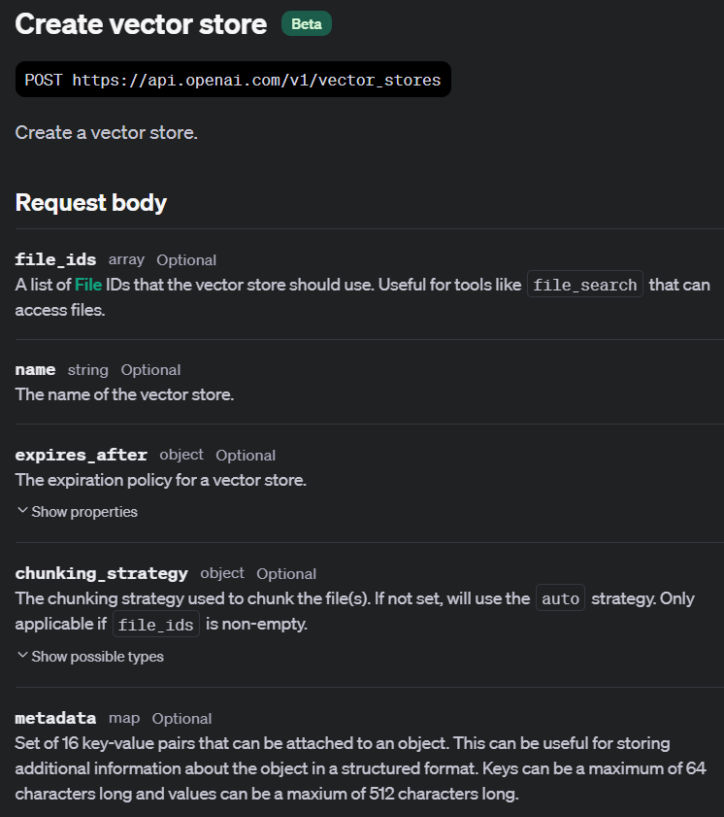
Creating Vector Stores
Notes:
https://platform.openai.com/docs/api-reference/vector-stores/create

Slide 5
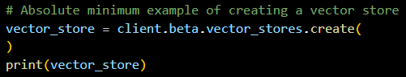
Demo: Creating a Simple, Empty Vector Store

Slide 6
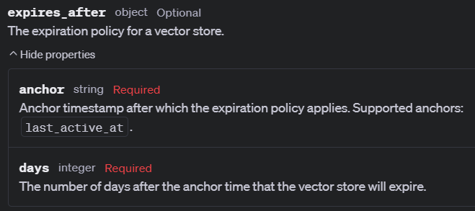
Expiration
Notes:
https://platform.openai.com/docs/api-reference/vector-stores/create#vector-stores-create-expires_after

Slide 7
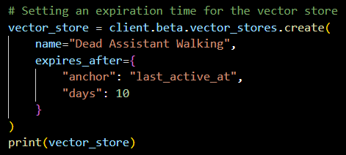
Demo: Setting an Expiration

Slide 8
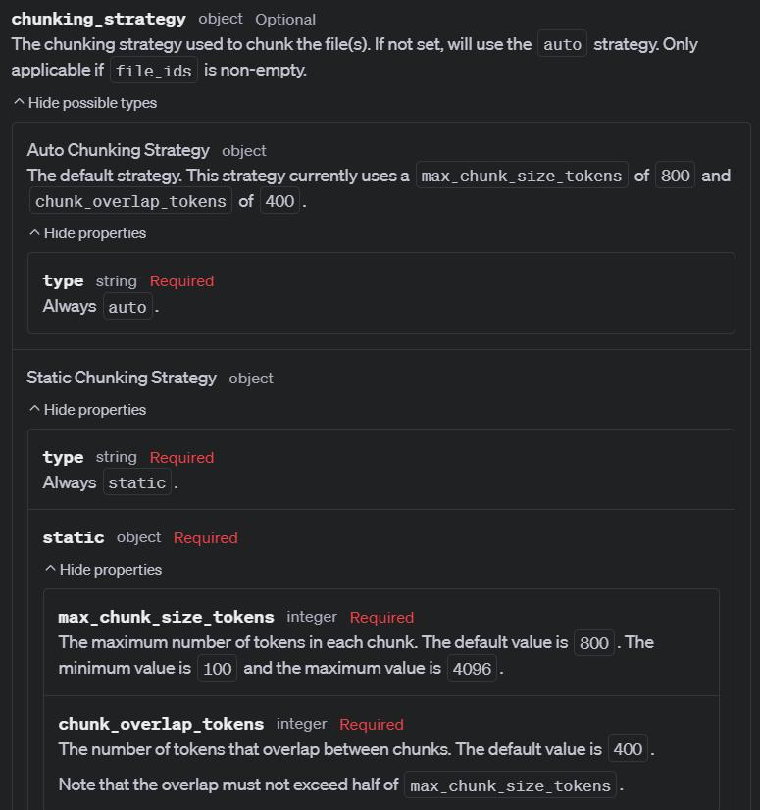
Chunking Strategy
Notes:
https://platform.openai.com/docs/api-reference/vector-stores/create#vector-stores-create-chunking_strategy

Slide 9
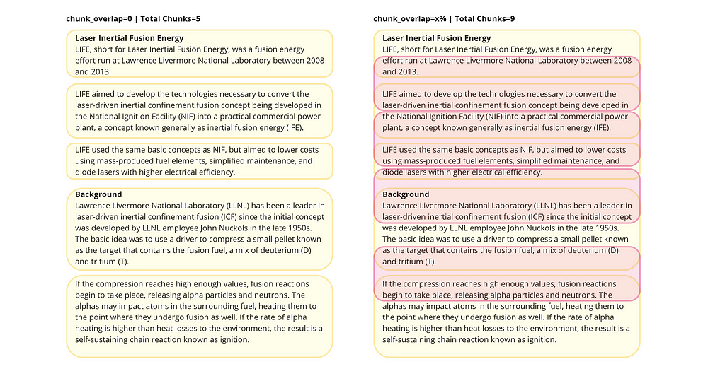
Chunking and Overlap
Notes:
https://gustavo-espindola.medium.com/chunk-division-and-overlap-understanding-the-process-ade7eae1b2bd

Slide 10
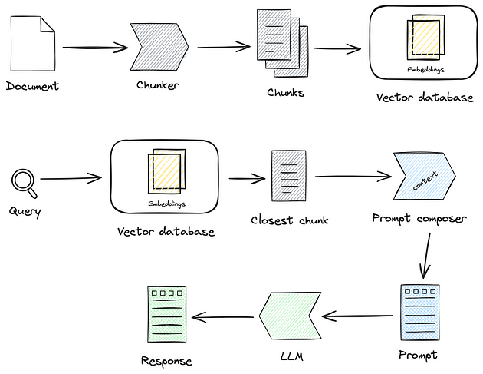
Notes:
https://medium.com/@hadiazouni/text-splitting-chunking-for-rag-applications-7ccbb6dcc9f9
https://shelf.io/blog/demystifying-content-chunking-in-ai-and-enterprise-knowledge-management/

Slide 11
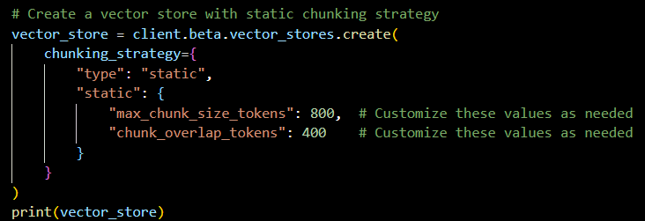
Demo: Manual Chunking Strategy

Slide 12
Listing Vector Stores
Let’s See Those Vector Stores!

Slide 13
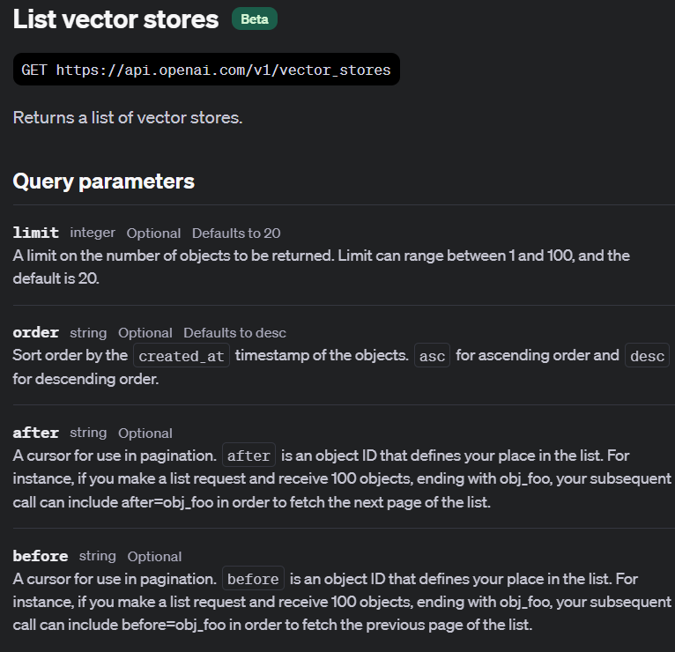
Listing Vector Stores

Slide 14
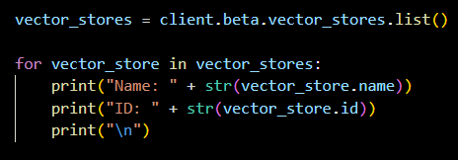
Demo: Simple List of Vector Stores

Slide 15
Retrieving & Updating Vector Stores
Let’s Get Our Vector Store and Make Some Changes

Slide 16
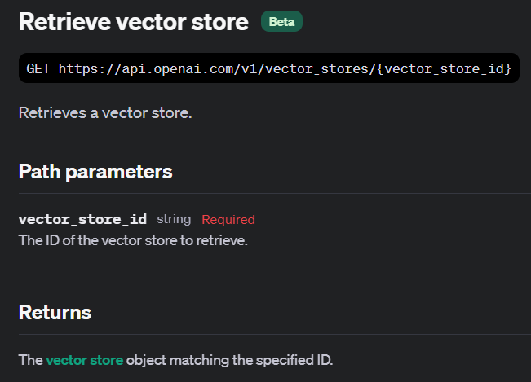
Notes:
https://platform.openai.com/docs/api-reference/vector-stores/retrieve

Slide 17
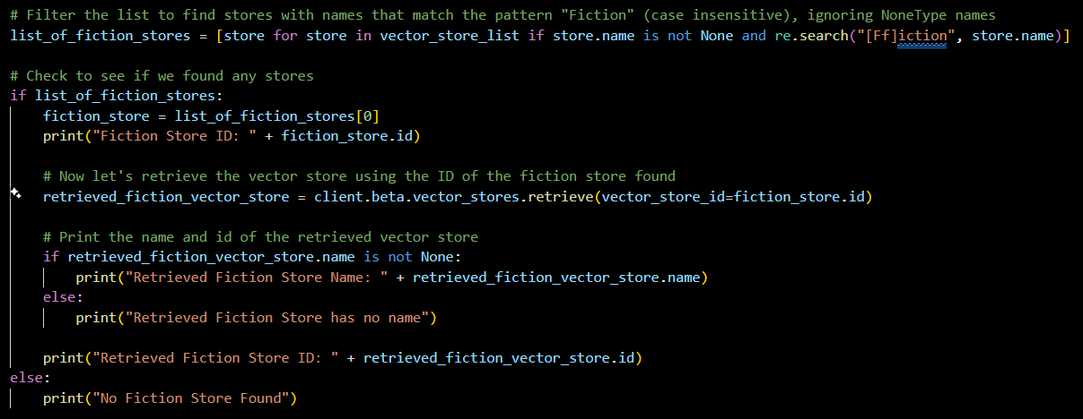
Demo: Retrieving a Vector Store

Slide 18
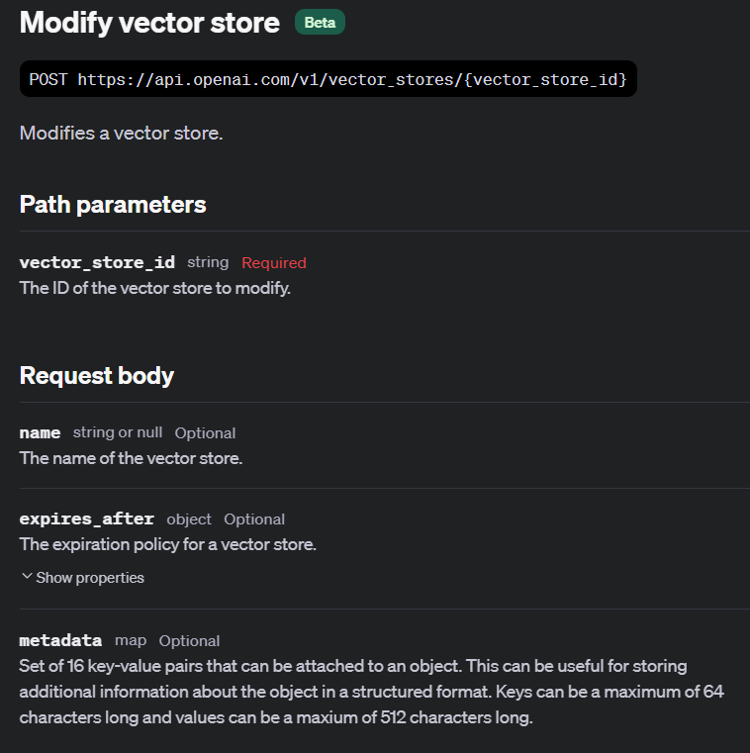
Notes:
https://platform.openai.com/docs/api-reference/vector-stores/modify

Slide 19
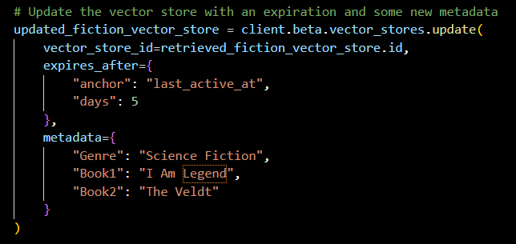
Demo: Updating a Vector Store

Slide 20
Deleting Vector Stores
Time for Cleanup!

Slide 21
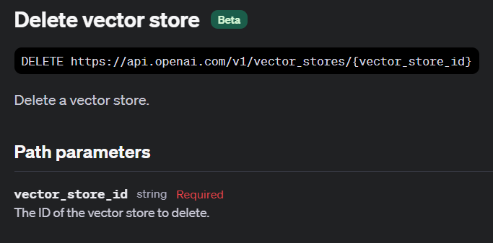
Notes:
https://platform.openai.com/docs/api-reference/vector-stores/delete

Slide 22
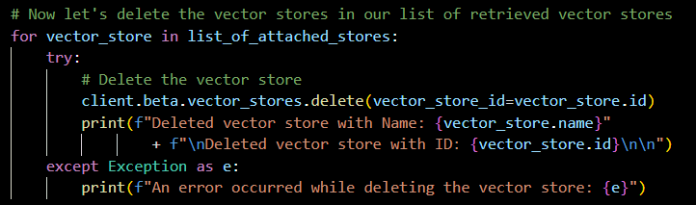
Demo: Deleting Vector Stores

Slide 23


